Slide 1
Phase II: Supply Chain Design
High Level Architecture
Nov 3, 2003

Slide 2
A potential architectural workaround for Perpetual Inventory without Purchase Orders for Business Release 1 has been considered…
PO - Purchase Order
electronic, email, Phone Call, Fax, or Representative
McKesson – Telxon / Pharmaclik, proprietary electronic
interface (Portal, Phone, or through POS in some stores)
Vendor
Store
Invoices &
Claims
Electronic (EDI/XML or proprietary) or Paper
Invoices & Claims need to be by Item
Vendors:
Distributors
  McKesson
  Lumsden
  K&F
DSD (Direct Store Delivery)
Sales
POS – Daily downloads
  Sales
Dispensary – Daily downloads
Katz
RSCM
Centrally controlled Item Master
Inventory – based on Invoices & Claims

Slide 3
… a potential architecture for Perpetual Inventory for Business Release 2 has been proposed
Minimize
PO - Purchase Order
electronic, email, Phone Call, Fax, or Representative
McKesson – Telxon / Pharmaclick, proprietary electronic
interface (Portal, Phone, or through POS in some stores)
Vendor
Store
PO – Purchase Order
Replenishment
Invoices &
Claims
Based on RMS
Inventory
SOQ – Suggested
Order Quantity
Send PO copy
Based on RMS Inventory
Based on SOQ response
from Stores
Electronic (EDI/XML or proprietary) or Paper
Invoices & Claims need to be by Item
Vendors:
Distributors
  McKesson
  Lumsden
  K&F
DSD (Direct Store Delivery)
Sales
SOQ
POS – Daily downloads
  Sales
Dispensary – Daily downloads
PO Copy
  Inventory
Katz
RSCM
Outsource electronic translation
  e.g. QLOGITEK
Centrally controlled Item Master
Inventory – based on Invoices & Claims
Maximize
Inventory based on POS/Dispensary
and Store responses to SOQ

Slide 4
Katz major Applications/Systems
CURRENT - HL Logical Architecture with key interfaces
FMS
Item
Master
Nexxsys
Admin
Other Apps
e.g. WCS, T/A, Payroll
JDE (DT)
GL, A/P, A/R
Air Miles
On Receipt
DWH Informix
Microstrategy
Nexxsys DB AS400
McKesson
Product Updates
CA (KGC)
Finance
Invoices
Reconciliation
Katz
Item
Cost
Retail
Rx Item
Updates
POS
Ordering
McKesson
WMS/TMS
Other
Vendors
Rx
Daily
Sales
Real
Time
Rx
Ordering
Vendors
POS
Daily Sales
Through AS400
Datamart
IMS
Real Time
Moneris
Banks
Upload
for Rx
Stores
Upload
POS sales
through
AS400
POS
AutoStar
Nexxsys
Dispensary
Insurance
Providers
Air Miles
Loyalty Group
Real Time
Adjudication
3rd Parties

Slide 5
Katz major Applications/Systems
Current – Interactions
Store POS interacts with
Send
Banks - Real time credit card and interact transactions (vpn, isdn, satellite)
KGC - Real time Air Mils on Receipt (not all stores) (vpn, isdn, satellite)
KGC - Batch Daily sales transactions (vpn, isdn, satellite)
McKesson - Ordering (Internet)
Receive
KGC - Updates from FMS (item, cost, retail) (vpn, isdn, satellite)
Store Dispensary system interacts with
Send
Third Party insurer - Real time claims processing (AJB / VPN)
KGC / DT - Batch Daily Rx sales transaction
McKesson - Ordering
Receive
DT - Rx price and item updates
Store Time and Attendance plus e-mail
Send
Employee payroll information (vpn)
E-mails (internal / external) (vpn)
Receives
E-mails (internal / external) (vpn)
FMS applications (as/400)
Send
Store POS - Batch item, cost, retail new and updates
KGC - Batch to Data Warehouse (ETL)
Receives
KGC - updates manual entry and via spreadsheet uploads
McKesson (company)
Send
KGC - Detail Shipment (invoice) (as/400 - as/400)
DT - Invoice File (as/400 - as/400)
DT - Product updates (as/400 - as/400)
Receive
KGC - Category codes (kgc internal)
CA Finance
Send
Receive
McKesson - Detail Shipment (Invoice) into A/P
JDE Finance (ar/ap/gl)
Manual processes
Connection via thin and phat clients
Send
Receive
Data Warehouse (Sun system)
Send
Receive
FMS - refresh of FMS item (ETL)
Store POS -Daily transactions (ETL)
Loyalty Group
Receives
KGC - Air Miles transactions (FTP)
Banks
Send
DT - Daily credit card transactions (DT dial up)
DT - Cheque reconciliation
Receives
DT - PAP and EFT data files (dial up via bank software)

Slide 6
Katz major Applications/Systems
TARGET - HL Physical Architecture with RSCM implementing EAI to reduce number and complexity of interfaces
FMS
Item
Master
Nexxsys
Admin
Other Apps
e.g. WCS, T/A, Payroll
JDE (DT)
GL, A/P, A/R
Air Miles
On Receipt
DWH Informix
Microstrategy
Nexxsys DB AS400
McKesson
Product Updates
CA (KGC)
Finance
Invoices
Reconciliation
Katz
RSCM
McKesson
WMS/TMS
Other
Vendors
EAI
Integration Broker
Vendors
Datamart
IMS
Real Time
Moneris
Banks
Stores
Upload
POS sales
through
AS400
POS
AutoStar
Nexxsys
Dispensary
Insurance
Providers
Air Miles
Loyalty Group
Real Time
Adjudication
3rd Parties

Slide 7
JDA Implementation High Level Architecture / Interfaces

Slide 8
Katz major Applications/Systems
BR1 TARGET - HL Logical Architecture
JDA Based Implementation
FMS
Nexxsys
Admin
Other Apps
e.g. WCS, T/A, Payroll
CA (KGC)
JDE
(DT & KGC)
GL, A/P, A/R
Air Miles
On Receipt
DWH Informix
Microstrategy
Nexxsys DB AS400
Invoices /
Inventory
Invoices
Reconciliation
Katz
McKesson &
Other Vendors
Product Updates
McKesson
WMS/TMS
Other
Vendors
RSCM BR1
Vendors
POS
Daily
Sales
Rx
Daily
Sales
Item
Price
Assortment
Promotion
Datamart
IMS
Real Time
Moneris
Banks
Stores
Upload
POS sales
through
AS400
POS
AutoStar
Nexxsys
Dispensary
Insurance
Providers
Air Miles
Loyalty Group
Real Time
Adjudication
3rd Parties

Slide 9
Katz major Applications/Systems
BR2 TARGET - HL Logical Architecture
JDA Based Implementation
FMS
Nexxsys
Admin
Other Apps
e.g. WCS, T/A, Payroll
CA (KGC)
JDE
(DT & KGC)
GL, A/P, A/R
Air Miles
On Receipt
DWH Informix
Microstrategy
Nexxsys DB AS400
Match Invoices /
Inventory
Invoices
Reconciliation
Katz
McKesson &
Other Vendors
Product Updates
Replenish / SOQ
Allocate
Plan / Forecast
McKesson
WMS/TMS
Other
Vendors
RSCM BR2
Vendors
POS
Daily
Sales
Rx
Daily
Sales
Item
Price
Assortment
Promotion
Manage POs
Datamart
IMS
Real Time
Moneris
Banks
POS
Inventory
Insurance
Providers
Upload
POS sales
through
AS400
Air Miles
Loyalty Group
POS
AutoStar
Nexxsys
Dispensary
Real Time
Adjudication
Stores
3rd Parties

Slide 10
Katz major Applications/Systems
BR3 TARGET - HL Logical Architecture
JDA Based Implementation
FMS
Nexxsys
Admin
Store T/A
Payroll
Other Apps
e.g. WCS, T/A, Payroll
CA (KGC)
JDE
(DT & KGC)
GL, A/P, A/R
Air Miles
On Receipt
DWH Informix
Microstrategy
Nexxsys DB AS400
Match Invoices /
Inventory
Invoices
Reconciliation
Katz
McKesson &
Other Vendors
Product Updates
Replenish / SOQ
Allocate
Plan / Forecast
McKesson
WMS/TMS
Other
Vendors
RSCM BR3
Vendors
POS
Daily
Sales
Rx
Daily
Sales
Item
Price
Assortment
Promotion
Manage POs
CPFR with Vendors
Datamart
IMS
Real Time
Moneris
Banks
POS
Inventory
Insurance
Providers
Upload
POS sales
through
AS400
Air Miles
Loyalty Group
POS
AutoStar
Nexxsys
Dispensary
Real Time
Adjudication
Stores
3rd Parties

Slide 11
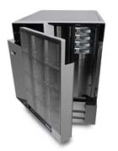




JDA Based Implementation
JDA Proposed Technical Architecture
Arthur / Intellect / Vista
App. Server
xSeries
SAN
Shark
PMM/ASR/Arthur
Server
pSeries
RetailIDEAS
Server
pSeries
Clients
Citrix
Server
xSeries
Store Portal Server
xSeries
PMM
RetailIDEAS
Arthur
Portals
1+2+1
0+1+0
1+2+1
HEAD OFFICE LAN
1+D*+D*
1+1+1
0+0+1
TCP/IP Backbone
Devt./QA/Training
Internet
VPN,
ADSL, Dial-up
ISDN
Satellite
Stores
External
Clients
STORE LAN
Tivoli
Sys.Mgmt
TBD
xSeries
Devt.
Server
pSeries
Devt.
App
Server
xSeries
Legend:
# Servers: BR1+BR2+BR3
D* - increased DASD
RF
Device
POS
Nexxsys
Store Portals
0+1+0
1+0+0
1+0+0

Slide 12
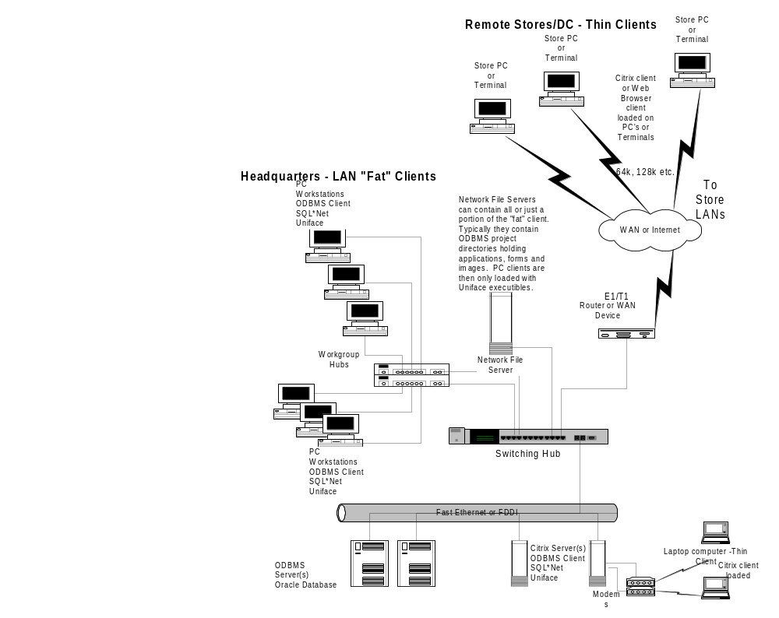
JDA Based
Implementation
PMM deployment
possibilities
Notes:
We will work with you to determine a Global System Image. The main point here is to determine the hardware that fits the customer environment. We will work out how to make our solution fit that environment.

Slide 13
SAP Implementation High Level Architecture / Interfaces

Slide 14
Katz major Applications/Systems
BR1 TARGET - HL Logical Architecture
SAP Based Implementation
FMS
Katz
Nexxsys
Admin
Other Apps
e.g. WCS, T/A, Payroll
CA (KGC)
JDE (DT)
GL, A/P, A/R
Air Miles
On Receipt
DWH Informix
Microstrategy
Nexxsys DB AS400
Invoices /
Inventory
SAP (KGC)
GL, A/P, A/R
Invoices
Reconciliation
McKesson &
Other Vendors
Product Updates
McKesson
WMS/TMS
Other
Vendors
RSCM BR1
Vendors
POS
Daily
Sales
Rx
Daily
Sales
Item
Price
Assortment
Promotion
Datamart
IMS
Real Time
Moneris
Banks
Stores
Upload
POS sales
through
AS400
POS
AutoStar
Nexxsys
Dispensary
Insurance
Providers
Air Miles
Loyalty Group
Real Time
Adjudication
3rd Parties

Slide 15
Katz major Applications/Systems
BR2 TARGET - HL Logical Architecture
SAP Based Implementation
FMS
Katz
Nexxsys
Admin
Other Apps
e.g. WCS, T/A, Payroll
CA (KGC)
JDE (DT)
GL, A/P, A/R
Air Miles
On Receipt
DWH Informix
Microstrategy
Nexxsys DB AS400
Match Invoices /
Inventory
SAP (KGC)
GL, A/P, A/R
Invoices
Reconciliation
McKesson &
Other Vendors
Product Updates
Replenish / SOQ
Allocate
Plan / Forecast
McKesson
WMS/TMS
Other
Vendors
RSCM BR2
Vendors
POS
Daily
Sales
Rx
Daily
Sales
Item
Price
Assortment
Promotion
Manage POs
Datamart
IMS
Real Time
Moneris
Banks
POS
Inventory
Insurance
Providers
Upload
POS sales
through
AS400
Air Miles
Loyalty Group
POS
AutoStar
Nexxsys
Dispensary
Real Time
Adjudication
Stores
3rd Parties

Slide 16
Katz major Applications/Systems
BR3 TARGET - HL Logical Architecture
SAP Based Implementation
FMS
Katz
Nexxsys
Admin
Other Apps
e.g. WCS, T/A, Payroll
CA (KGC)
Store T/A
Payroll
JDE (DT)
GL, A/P, A/R
Air Miles
On Receipt
DWH Informix
Microstrategy
Nexxsys DB AS400
Match Invoices /
Inventory
SAP (KGC)
GL, A/P, A/R
Invoices
Reconciliation
McKesson &
Other Vendors
Product Updates
Replenish / SOQ
Allocate
Plan / Forecast
McKesson
WMS/TMS
Other
Vendors
RSCM BR3
Vendors
POS
Daily
Sales
Rx
Daily
Sales
Item
Price
Assortment
Promotion
Manage POs
CPFR with Vendors
Datamart
IMS
Real Time
Moneris
Banks
POS
Inventory
Insurance
Providers
Upload
POS sales
through
AS400
Air Miles
Loyalty Group
POS
AutoStar
Nexxsys
Dispensary
Real Time
Adjudication
Stores
3rd Parties

Slide 17
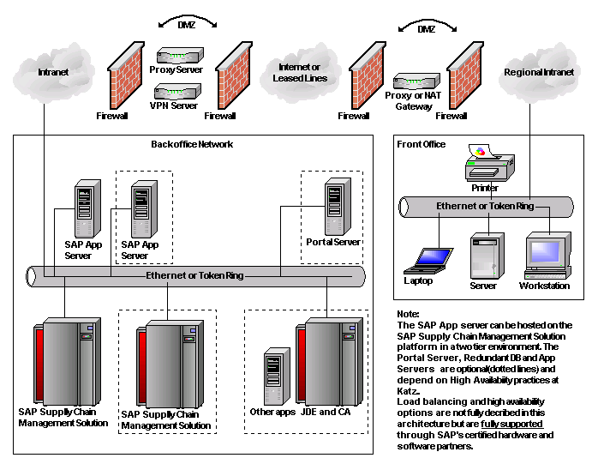
SAP Proposed
Technical Architecture
SAP Based Implementation
Tivoli
Sys.MgmTBD
Devt.
Server
Devt.
App
Server
VPN,
ADSL, Dial-up
ISDN
Satellite
Stores
STORE LAN
RF
Device
POS
Nexxsys
Store Portals

Slide 18
High Level System / Data Management

Slide 19
System / Data Management - RSCM Flows have driven additional requirements
Inputs
POS
(Sales)
Dispensary
WMS/TMS (McKesson)
Purchasing (Purchase Mgmt System -Invoices)
Financial Data
Master File Updates
(Item, vendor, price, promo)
Merchandise Planning Budgets (e.g. Excel)
Outputs
Planograms
Payment Authorization
DW (Data Warehouse)
  Reporting
  OLR (On Line Reporting)
  SRM
  CRM
  Analysis
PO (Purchase Orders)
Demand (SOQ)
Forecasting
RSCM
Item
Pricing
Cost
Vendor
Promo
Clusters
Hierarchies
Historical Data (sales, inventory, forecasts)

Slide 20
System / Data Management - RSCM Flows have driven additional requirements – more detail
Item
SKU Listing
Cost
Retails
Price Changes
Clusters
E.g. Assortment
Demand Clustering
  Item / Category /
  Dept
  Store
RSCM
Item
Pricing
Cost
Vendor
Promo
Clusters
Hierarchies
Historical Data (sales, inventory, forecasts)
Vendor
List Vendors
Terms
Inventory
OH = OH Physical Count
– Sales from POS
+ Receipts on Store level, received
against Event Shipment Notification
- Claims RTV, Shorts, Damages etc.
Promo
Pricing Short Term
Time
Hierarchies
Merchandise
Operations
See next page

Slide 21
Hierarchies – Operations and Merchandise
Operations hierarchy:
Banner:
  IDA / Guardian / IND / MS
  PP / Rexall / Herbins etc.
Geography – Central / East / West
Regions (Districts) – by Store, by Location
Province – by Store, by Location
Merchandise hierarchy:
Banner ?
Division
Department
Category
Class – e.g. defined by ECCNet, as per NWDA (McKesson)
Item
UPC (SKU not used):
Note: currently, multiple merchandise hierarchy models used, one is recommended
  Finance
  Stores
  Microstrategy
  McKesson

Slide 22
Backup - JDA Implementation notes

Slide 23
JDA Implementation Cost 1 of 2 – Servers (BR1)
Name | # | CPU | Memory | DASD |  | $ Cost
PMM, IKB | 1 | IBM p690 4 CPU | 4GB | 250GB
App Server: Vista | 1 | Pentium III 700+ 4 CPU | 2GB | 20GB
Citrix | 1 | Pentium III 700+ 4 CPU | 2GB | 20GB
Development Server | 1 | 4 CPU (Logical Partition of PMM p690) | 4GB | 250GB
Development App Server | 1 | Pentium III 700+ 4 CPU | 2GB | 20GB
Note: IBM p690 4 CPU requirement could be separate box or expanded original box by 4 CPUs)

Slide 24
JDA Implementation Cost 1 of 2 – Servers (BR2 - Incremental)
Name | # | CPU | Memory | DASD |  | $ Cost
PMM, IKB, +ASR | 1 | +4 CPU’s IBM p690 | +4GB | +500GB
App Server: Intellect/ ASR | +2 | Pentium III 700+ 4 CPU | 2GB | 20GB
Portal | +1 | Pentium III 700+ 4 CPU | 2GB | 20GB
Citrix | +2 | Pentium III 700+ 4 CPU | 2GB | 20GB
Development | No Change
Note: IBM p690 4 CPU requirement could be separate box or expanded original box by 4 CPUs)

Slide 25
JDA Implementation Cost 1 of 2 – Servers (BR3 - Incremental)
Name | # | CPU | Memory | DASD |  | $ Cost
PMM, IKB ASR, +Arthur | 1 | +4 CPU IBM p690 | +4GB | +250GB
App Server: Arthur a | +1 | Pentium III 700+ 4-way | 2GB RAM | 20GB
Retail IDEAS | 1 | IBM p690 +4 CPU | 8GB | 1TB
Portal | No Change
Citrix | +1 | Pentium III 700+ 4-way | 2GB RAM | 20GB
Development | No Change
Note: IBM p690 4 CPU requirement could be separate box or expanded original box by 4 CPUs)

Slide 26
JDA Implementation Cost 2 of 2
Workstations / Clients
  Required: Windows 98/NT/2000, Pentium 266+, 128MB Ram+, 300MB DASD, (IE 5.0+)
Environment Software
  3 x Oracle 9i Licenses/Servers
  1 x Pro*C, 1 x C Compiler for PMM Server
  4 x Citrix Licenses/Servers
  Operating Systems (assumed included in hardware – To Be confirmed)
Networking (To be defined)
  Routers, hubs, switches, modems
  T1 ?

